Slide 1
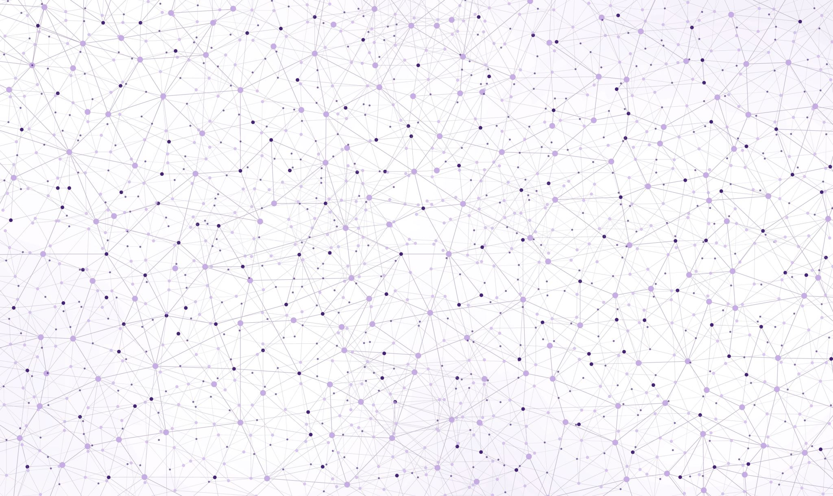
Support Vector Machine
Dr. Risman Adnan Mattotorang
Telkom University

Slide 2
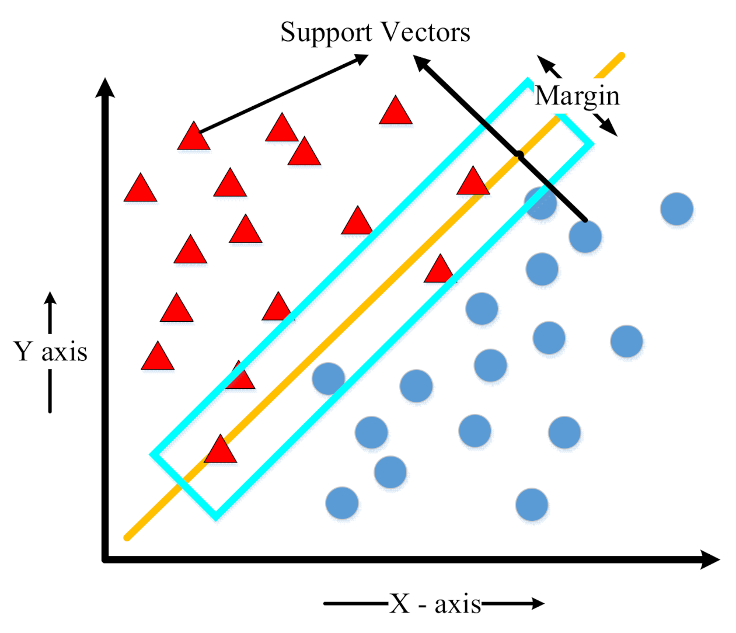
Outline
Vector and Hyperplane
Main Ideas of SVM
SVM Optimization Problem
Non-Linear SVMs
Introduction to Kernels

Slide 3
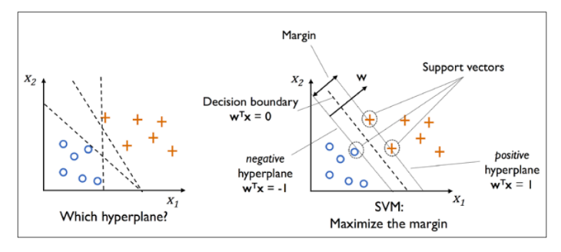
Vector and Hyperplane
This line represents the decision boundary: ax1 + bx2 − c = 0
Vector and Hyperplane
Lots of possible solutions for a, b, c.
Some methods find a separating hyperplane, but not the optimal one [according to some criterion of expected goodness]
E.g., perceptron
Support Vector Machine (SVM) finds an optimal* solution.
Maximizes the distance between the hyperplane and the “difficult points” close to decision boundary
One intuition: if there are no points near the decision surface, then there are no very uncertain classification decisions

Slide 4
Perceptron Revisited
w^{T}x + b = 0
w^{T}x + b > 0
w^{T}x + b < 0
Perceptron is Linear Separator
Binary classification can be viewed as the task of separating classes in feature space
f(x) = sign(w^{T}x + b)

Slide 5
Outline
Vector and Hyperplane
Main Ideas of SVM
SVM Optimization Problem
Non-Linear SVMs
Introduction to Kernels

Slide 6
Intuition of SVM
Sec. 15.1
If you have to place a fat separator between classes, you have less choices, and so the capacity of the model has been decreased

Slide 7
Geometric Margin
Distance from example x_{i} to the separator is:
Examples closest to the hyperplane are support vectors.
Margin ρ of the separator is the distance between support vectors.
ρ
r

Slide 8
Maximum Margin Classification
Maximizing the margin is good according to intuition and PAC theory.
Implies that only support vectors matter; other training examples are ignorable.

Slide 9
Support Vector Machine (SVM)
Sec. 15.1
SVMs maximize the margin around the separating hyperplane.
A.k.a. large margin classifiers
The decision function is fully specified by a subset of training samples, the support vectors.
Solving SVMs is a quadratic programming problem
Seen by many as the most successful current text classification method*
Support vectors
Maximizes
margin
Narrower
margin
*but other discriminative methods often perform very similarly

Slide 10
Linear SVM Mathematically The linearly separable case
Sec. 15.1
ρ
w^{T}x_{a} + b = 1
w^{T}x_{b} + b = -1
Assume that all data is at least distance 1 from the hyperplane, then the following two constraints follow for a training set {(x_{i} ,y_{i})}
For support vectors, the inequality becomes an equality. Then, since each example’s distance from the hyperplane is:
The margin is:
w^{T}x_{i} + b ≥ 1 if y_{i} = 1
w^{T}x_{i} + b ≤ −1 if y_{i} = −1
Hyperplane w^{T} x + b = 0
Extra scale constraint:
min_{i=1,…,n} |w^{T}x_{i} + b| = 1
This implies:
w^{T}(x_{a}–x_{b}) = 2
ρ = ||x_{a}–x_{b}||₂ = 2/||w||₂
w^{T} x + b = 0

Slide 11
Linear SVM Mathematically
Sec. 15.1
Then we can formulate the quadratic optimization problem:
A better formulation (min ||w|| = max 1/ ||w|| ):
Find w and b such that
is maximized; and for all {(x_{i} , y_{i})}
w^{T}x_{i} + b ≥ 1 if y_{i}=1; w^{T}x_{i} + b ≤ -1 if y_{i} = -1
Find w and b such that
Φ(w) =½ w^{T}w is minimized;
and for all {(x_{i} ,y_{i})}: y_{i} (w^{T}x_{i} + b) ≥ 1

Slide 12
Outline
Vector and Hyperplane
Main Ideas of SVM
SVM Optimization Problem
Non-Linear SVMs
Introduction to Kernels

Slide 13
Solving the Optimization Problem
Sec. 15.1
This is now optimizing a quadratic function subject to linear constraints
Quadratic optimization problems are a well-known class of mathematical programming problem, and many (intricate) algorithms exist for solving them (with many special ones built for SVMs)
The solution involves constructing a dual problem where a Lagrange multiplier α_{i} is associated with every constraint in the primary problem:
Find w and b such that
Φ(w) =½ w^{T}w is minimized;
and for all {(x_{i} ,y_{i})}: y_{i} (w^{T}x_{i} + b) ≥ 1
Find α₁…α_{N} such that
Q(α) =Σα_{i} - ½ΣΣα_{i}α_{j}y_{i}y_{j}x_{i}^{T}x_{j} is maximized and
(1) Σα_{i}y_{i} = 0
(2) α_{i} ≥ 0 for all α_{i}

Slide 14
The Optimization Problem Solution
Sec. 15.1
The solution has the form:
Each non-zero α_{i} indicates that corresponding x_{i} is a support vector.
Then the classifying function will have the form:
Notice that it relies on an inner product between the test point x and the support vectors x_{i}
We will return to this later.
Also keep in mind that solving the optimization problem involved computing the inner products x_{i}^{T}x_{j} between all pairs of training points.
w =Σα_{i}y_{i}x_{i} b= y_{k}- w^{T}x_{k} for any x_{k} such that α_{k}≠ 0
f(x) = Σα_{i}y_{i}x_{i}^{T}x + b

Slide 15
Soft Margin Classification
Sec. 15.2.1
If the training data is not linearly separable, slack variables ξ_{i} can be added to allow misclassification of difficult or noisy examples.
Allow some errors
Let some points be moved to where they belong, at a cost
Still, try to minimize training set errors, and to place hyperplane “far” from each class (large margin)
ξ_{i}
ξ_{j}

Slide 16
Soft Margin Classification Mathematically
Sec. 15.1
The old formulation:
The new formulation incorporating slack variables:
Parameter C can be viewed as a way to control overfitting
A regularization term
Find w and b such that
Φ(w) =½ w^{T}w is minimized and for all {(x_{i} ,y_{i})}
y_{i} (w^{T}x_{i} + b) ≥ 1
Find w and b such that
Φ(w) =½ w^{T}w + CΣξ_{i} is minimized and for all {(x_{i} ,y_{i})}
y_{i} (w^{T}x_{i} + b) ≥ 1- ξ_{i} and ξ_{i} ≥ 0 for all i

Slide 17
Soft Margin Classification Mathematically
Sec. 15.1
The dual problem for soft margin classification:
Neither slack variables ξ_{i} nor their Lagrange multipliers appear in the dual problem!
Again, x_{i} with non-zero α_{i} will be support vectors.
Solution to the dual problem is:
Find α₁…α_{N} such that
Q(α) =Σα_{i} - ½ΣΣα_{i}α_{j}y_{i}y_{j}x_{i}^{T}x_{j} is maximized and
(1) Σα_{i}y_{i} = 0
(2) 0 ≤ α_{i} ≤ C for all α_{i}
w is not needed explicitly for classification!
w = Σα_{i}y_{i}x_{i}
b = y_{k}(1- ξ_{k}) - w^{T}x_{k} where k = argmax α_{k’}
f(x) = Σα_{i}y_{i}x_{i}^{T}x + b
k’

Slide 18
Classification with SVMs
Sec. 15.1
Given a new point x, we can score its projection onto the hyperplane normal:
I.e., compute score: w^{T}x + b = Σα_{i}y_{i}x_{i}^{T}x + b
Decide class based on whether < or > 0
Can set confidence threshold t.
Score > t: yes
Score < -t: no
Else: don’t know
1
0
-1

Slide 19
Linear SVMs: Summary
Sec. 15.2.1
The classifier is a separating hyperplane.
The most “important” training points are the support vectors; they define the hyperplane.
Quadratic optimization algorithms can identify which training points x_{i} are support vectors with non-zero Lagrangian multipliers α_{i}.
Both in the dual formulation of the problem and in the solution, training points appear only inside inner products:
Find α₁…α_{N} such that
Q(α) =Σα_{i} - ½ΣΣα_{i}α_{j}y_{i}y_{j}x_{i}^{T}x_{j} is maximized and
(1) Σα_{i}y_{i} = 0
(2) 0 ≤ α_{i} ≤ C for all α_{i}
f(x) = Σα_{i}y_{i}x_{i}^{T}x + b

Slide 20
Outline
Vector and Hyperplane
Main Ideas of SVM
SVM Optimization Problem
Non-Linear SVMs
Introduction to Kernels

Slide 21
Non-linear SVMs
Sec. 15.2.3
Datasets that are linearly separable (with some noise) work out great:
But what are we going to do if the dataset is just too hard?
How about … mapping data to a higher-dimensional space:
0
x
0
x
x²
0
x

Slide 22
Non-linear SVMs: Feature spaces
Sec. 15.1
General idea: the original feature space can always be mapped to some higher-dimensional feature space where the training set is separable:
Φ: x → φ(x)

Slide 23
The “Kernel Trick”
Sec. 15.1
The linear classifier relies on an inner product between vectors K(x_{i},x_{j})=x_{i}^{T}x_{j}
If every datapoint is mapped into high-dimensional space via some transformation Φ: x → φ(x), the inner product becomes:
K(x_{i},x_{j})= φ(x_{i}) ^{T}φ(x_{j})
A kernel function is some function that corresponds to an inner product in some expanded feature space.
Example:
2-dimensional vectors x=[x₁ x₂]; let K(x_{i},x_{j})=(1 + x_{i}^{T}x_{j})²,
Need to show that K(x_{i},x_{j})= φ(x_{i}) ^{T}φ(x_{j}):
K(x_{i},x_{j})=(1 + x_{i}^{T}x_{j})²,= 1+ x_{i1}²x_{j1}² + 2 x_{i1}x_{j1} x_{i2}x_{j2}+ x_{i2}²x_{j2}² + 2x_{i1}x_{j1} + 2x_{i2}x_{j2}=
= [1 x_{i1}² √2 x_{i1}x_{i2} x_{i2}² √2x_{i1} √2x_{i2}]^{T} [1 x_{j1}² √2 x_{j1}x_{j2} x_{j2}² √2x_{j1} √2x_{j2}]
= φ(x_{i}) ^{T}φ(x_{j}) where φ(x) = [1 x₁² √2 x₁x₂ x₂² √2x₁ √2x₂]

Slide 24

Kernels
Sec. 15.2.3
Why use kernels?
Make non-separable problem separable.
Map data into better representational space
Common kernels
Linear
Polynomial K(x,z) = (1+x^{T}z)^{d}
Gives feature conjunctions
Radial basis function (infinite dimensional space)
Haven’t been very useful in text classification

Slide 25
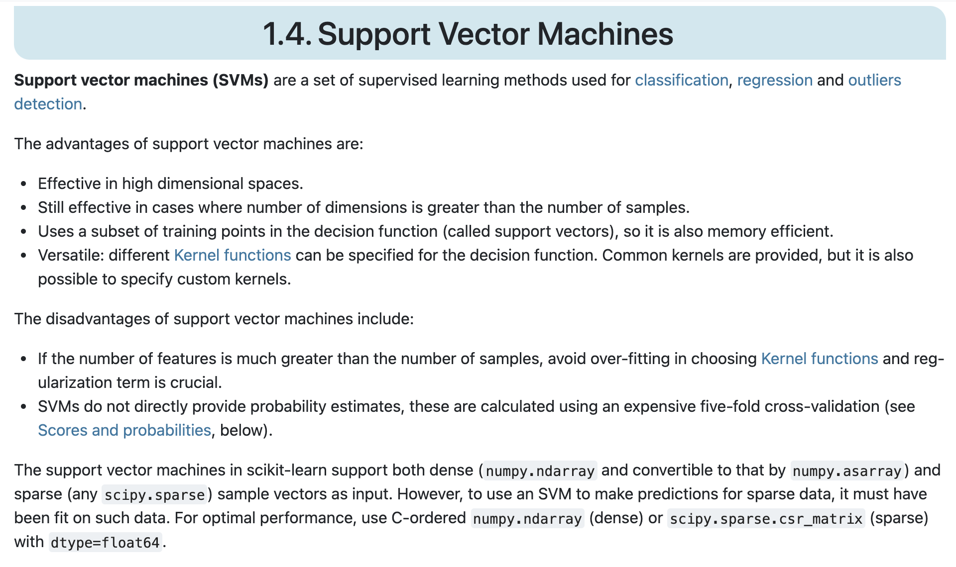
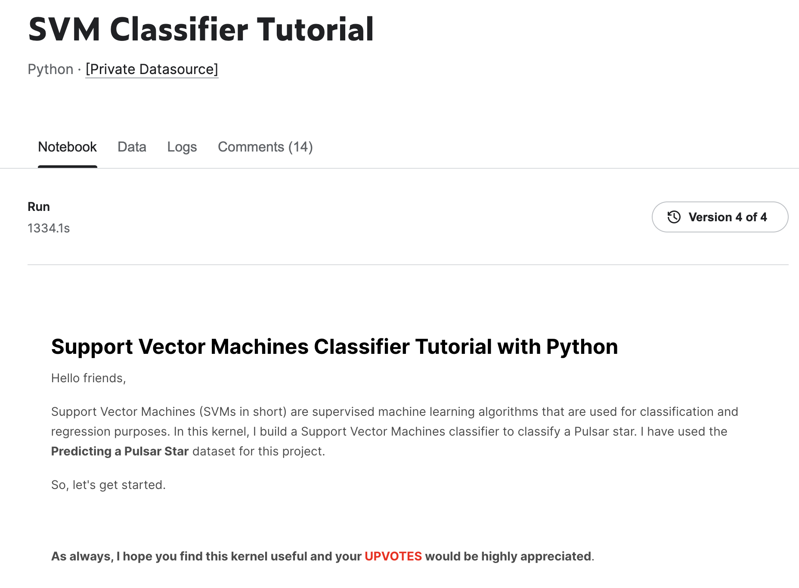
Home Works
Scikit Learn
Kaggle

Slide 26
Summary
Sec. 15.2.3
Support vector machines (SVM)
Choose hyperplane based on support vectors
Support vector = “critical” point close to decision boundary
(Degree-1) SVMs are linear classifiers.
Kernels: powerful and elegant way to define similarity metric
Perhaps best performing text classifier
But there are other methods that perform about as well as SVM, such as regularized logistic regression (Zhang & Oles 2001)
Partly popular due to availability of good software
SVMlight is accurate and fast – and free (for research)
Now lots of good software: libsvm, TinySVM, ….
Comparative evaluation of methods
Real world: exploit domain specific structure!

